Slide 1

Department of Information Technology
A.P. Shah Institute of Technology
G.B.Road,Kasarvadavli, Thane(W), Mumbai-400615
UNIVERSITY OF MUMBAI
Academic Year 2019-2020

Slide 2
A Project Report on
ParkMania : The Parking Management System
Submitted in partial fulfillment of the degree of
Bachelor of Engineering(Sem-7)
in
INFORMATION TECHNOLOGY
By
Saurabh Sharma(16104001) Srinivas Vishwanath(16104010)
Under the Guidance of
Mrs. Poonam Dhawale Mrs. Sneha Kanchan

Slide 3
1.Project Conception and Initiation

Slide 4
1.1 Abstract
Due to the increasing population in urban cities, there is an exponential rise in the number of vehicles which is leading to major problems leading to poor traffic management and congestion. Another major problem face by the vehicle owners is the availability of parking space. The idea of Smart Cities is slowly gaining pace with the ever increasing technologies. Therefore, in the proposed parking system we are developing and application which can be used to either book or pre-book a slot. The vehicle owner will be able to reserve a slot for his/her vehicle from anywhere and will be provided with a QR code which will be scanned on the entry of the parking area. This QR code will be displayed on the e-receipt of that particular vehicle owner. Also the problem of finding a vacant parking areas in big cities will be taken care of by our system as the vehicle owner will be guided to the particular parking area by the app itself with the help of maps. This application can therefore prove to an blessing to modern cities which will drastically minimize the chaos which is caused and help improve the traffic conditions. The corresponding user details and the details of their vehicles will be stored on the database which can be referred to anytime, thus providing security.

Slide 5
1.2 Objectives
Faster reservation of a parking slot anytime and from anywhere.
Providing information about nearby parking slots that are vacant.
Online payment portal integration making it easier for the vehicle owners to complete the transaction.
Graph Analysis depicting the typical peak hours when the parking area is most/least occupied.
QR code for verifying the user who has booked/reserved the parking slot.
Payment calculation based on time for which the vehicle was parked.
Storage of the vehicle and owner details in the backend.

Slide 6
1.3 Literature Review
Paper Title: Low Cost Smart Parking System for Smart Cities. Authors: D.Vakula and Yeshwanth Krishna Kolli Publication Details: 2017 IEEE Xplore Compliant(ICISS 2017)
Findings: From this system we found out how ultrsonic sensors can be integrated with Raspberry Pi and Node MCU and how the information from Rasberry Pi can be transmitted to the front end GUI and back end database.
Advantages: -
It provides GUI so that you can see the available slots.
Disadvantages: -
No solution if parking slots are full.
Does not display nearby parking area within the vicinity of the original parking area.

Slide 7
Paper Title: Advanced car parking system usingarduino. Authors: Hemant Chaudhary, Prateek Bansal, Dr.B. Valarmathi Publication Details: 2017 International Conference On Advanced Computing and Communication Systems(ICASS-2017)
Findings: From this system, we found out how security and authorization of every vehicle owner is achieved using RFID tag. It also explains how to display the information of vacant parking slots on a LCD.
Advantages: -
Every user gets an authorization RFID card which is verified and thereby only authentic car owners are allowed and only then will the gate open.
Security is thereby taken care of.
Disadvantages: -
No GUI provided to see the available slots.
Since arduino was used external wifi module was required to transmit data to application

Slide 8
Paper Title: Automatic car parking system with visual indicator along withiot. Authors: Sarthak Mendiratta, Debopam Dey, Deepika Rani Sona. Publication Publication Details: 2017 International Conference on Micro-electronic devices.
Findings: From this system, we learn how Wireless Sensor Network Technology is used to show if a parking slot is vacant or not usingLEDs.
Advantages: -
GUI is provided which helps the user to know before hand which parking slot is empty.
Disadvantages: -
No online payment feature included.
Nearby parking areas are not displayed in case the parking is full.

Slide 9
Paper Title: IoT based vehicle parking manager. Authors: J Desai, A Bhanje, S Biradar, D Fernandes Publication Details: 2017 7th International Conference on Cloud Computing, Data Science & Engineering - Confluence.
Findings: From this paper we have understood how Raspberry Pi Camera Module is used to scan the QR code along with the ultrasonic sensor to detect the presence of a vehicle and verification of the user. Servo Motor was used to control the opening and closing of the gate at the entrance after verification.
Advantages: -
Raspberry Pi Camera module is used which records high definition photographs to scan QR codes.
Only authenticated users can enter the parking area by scanning the QR code, hence, security was maintained.
LCD for displaying the car number and the booked slots.
Disadvantages: -
This system fails to direct a vehicle to the vacant parking slot through GUI.
Therefore in bigger parking areas, this system may have limitations

Slide 10
Paper Title: IoT based smart parking system. Authors: Khanna, A., & Anand, R Publication Details: 2016 International Conference on Internet of Things and Applications (IOTA).
Findings: In this paper we have learnt how we can integrated the cloud with the system to store the vehicle details. Also, parking cost based on time is calculated and time out notifications are sent to user using android application which keeps them updated.
Advantages: -
Cloud is used for storing large amounts of user data.
In case of system failure, it provides quick recovery and backup services.
Disadvantages: -
No provision provided for offline booking of parking slots.

Slide 11
1.4 Problem Definition
As the city is developing and with increase in population, people are finding it difficult to park their vehicles.
In some parking place there is no safety for the vehicle.
There is a chance of theft or vehicles may get damaged.
People waste their time to search vehicle parking place.
To solve these problems Online Vehicle Parking Monitoring is used.
The basic concept behind this project is that it reduces the time of the customer by providing proper packing facility.
Any customer can book the available parking slot with particular time.
This provides security to the customer.
People keep roaming around in search of vacant parking slots, and after a lot of struggle, they find one.
Due to lack of a proper mechanism to identify free parking slots, they move randomly in search of parking space wasting a lot of time.
This problem can be solved if the drivers could check the availability of parking spaces in and around their intended destination.

Slide 12
1.5 Scope
We focus on implementing our system at the college level. Following will be the benefits for the students/faculty members:
Ease for finding vacant parking slots.
Incase the parking area is full, our system will list out and help users get information about nearby parking areas.
The user will also be able to book a slot in the nearest parking area.
Separate spaces for 2-wheeler and 4-wheeler parking.
Security is provided as user details are stored in the backend.

Slide 13
1.6 Technology stack
Android Studio – For designing and building the application.
Firebase – For backend storage of live user details and parking details.
Cloud Messaging (Firebase) – For sending push notifications alerting the user if they have exceeded the time limit.
QR Code – For marking the presence/absence of the vehicle.

Slide 14
1.7 Benefits for environment & Society
Following are the benefits or contribution of our application:
With the help of this application the user can prebook a parking slot and not worry about finding a parking area.
If the main parking area is fully packed, the user can look fornearby parking areas in vicinity to the main area, this therefore avoids the chaosand solves the problem of people parking their vehicles anywhere.

Slide 15
2. Project Design

Slide 16
2.1 Proposed System
Our proposed system works in the following way:
1. Vehicle Owner books/reserves the parking slot using the mobile application by selecting the date and time.
2. In turn the user will get a QR code which will be used for verification later.
3. A window of 2 hours will be provided to the user within which he/she has to reach the parking area else, reservation is cancelled.
4. At the entrance, the user verifies the identity using the QR code and is assigned a particular parking slot based on the type of vehicle (car/bike).
5. The details are stored at the backend when the QR code is scanned.
6. An additional feature our system provides is that it displays the nearby parking areas. This feature is included because if the current parking area is full, the user can check for the nearby area where the vehicle can be parked.
7. The application contains two zones A and B for bikes and cars respectively.
8. The application displays booked, prebooked and occupied slots with the help of GUI.
9. Additional amount is imposed if a user extends the parking time.
10. If the user does not have an application or internet connectivity, then booking for that particular user will be done right at entrance of the parking area by providing a receipt or ticket.
Therefore additional features our system is providing is:
• Pre booking a slot based on time. • Real time updates of slot occupancy, • Information about nearby vacant parking slots within the vicinity of the main parking slot. Booking the slots in the nearby parking area.

Slide 17
2.2 Design(Flow Of Modules)
The design of our application consists of the following:
1. Login and sign up screen for identifying a user uniquely.
2. On successful login, the user is guided to the home page where user get three options where he can book a slot, check for nearby areas and book a slot in nearby area.
3. On selecting book a slot, the next page will give you to the option to select the type of vehicle i.e. is either two wheeler or four wheeler.
4. Next you select the zone (A or B) and the slot where you want to park the vehicle.
5. The available slot will be displayed using green.
6. The occupied slots are displayed by red and the user would not be able to select that slot.
7. When the vacant slot is selected you need to provide the necessary time and date.
8. Next you are guided to the payment gateway where you can pay as per the time which is calculated on the basis of time. 9. On successful payment an e-receipt is generated which contains a QR code which will be scanned during the entrance for the unique identity of the user.
10. On selecting nearby parking areas, a map displaying the nearby areas is selected.
11. On clicking ‘Book nearest parking area’ you can book a parking slot in a area which is in vicinity to the main parking area.

Slide 18
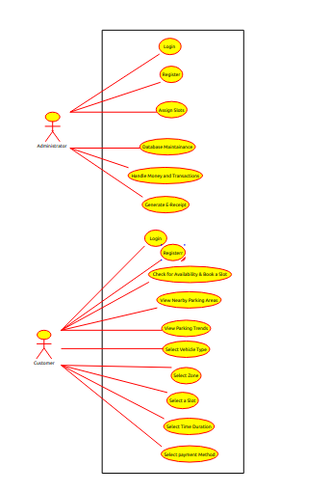
2.3 Description Of Use Case
Our use case consists of two major entities that interact with the major modules of the application.
The first one is the customer who can sign up/login, book a slot check for nearby areas, book a slot in nearby parking area.
The second is the administrator who has an access to access the backend database enter and manage records, handle payments and transactions.

Slide 19
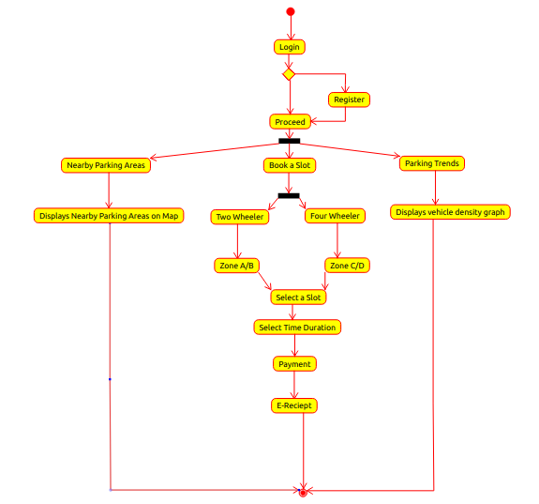
2.4 Activity diagram
Activity Diagram begins with the login or signup page after which the user can either book a slot or check for nearby parking areas.
Further there are zones for 2 wheeler and 4 wheeler parking which the user should select providing the necessary date and time for booking the slot.
Accordingly the price will be calculated and the user will need to make the payment theough the payment gateway.
An E-receipt containing the transaction and parking details will be generated which will also have an QR code which the user will have to scan on the entrance of the parking area.

Slide 20
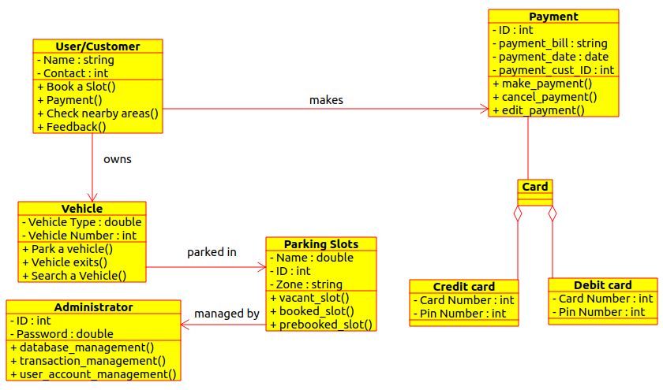
2.5 Class Diagram
The class diagram alongside displays various modules of our application interacting with each other.
As it can be seen, the class customer is associated to payment class as customer makes the payment.
Similarly, admin monitors and manages the parking slots, the vehicle is parked in these slots.
Payment is further divided into Credit card and Debit card payment.

Slide 21
2.6 Module-1 (Login/Register)
For the particular user to sign in to his account to make the booking.
If the user is not registered, he/she will have to get create a new login and then log in.
If suppose the user forgets the password he can click on the forget password option which sends a link to the user’s email to reset the password.

Slide 22
Module-2(Booking a Slot)
On clicking on ‘Book a Slot’ option, the user will be asked to select the type of vehicle owned by him (i.e. 2 wheeler or 4 wheeler).
Further there will be zones classified based on the type of vehicle (A,B,C,D)
After which the user can select the available slots displayed in green.
Already booked and occupied slots cannot be displayed.

Slide 23
Module-3(Date and Time)
After the selection of a slot, the user is asked to provide the day and the time for which the vehicle needs to be parked.
On the basis of the time, the payment calculation is done and the amount that is to be paid is generated.
The above details are simultaneously stored on the backend database.

Slide 24
Module-4(Payment Gateway)
The necessary payment calculation is done and the customer is further guided to make the payment.
The integration of payment gateway helps the customer to do so electronically.
The payment can be made using PayTm, credit or debit cards.

Slide 25
Module-5(E-Receipt)
The E-receipt is generated on successful payment.
This e-receipt contains the payment and parking details that are fetched from the backend database.
An additional QR code will also be visible on this receipt which the customer will scan while entering the parking area.

Slide 26
Module-6(Nearby Parking Areas)
The nearby parking area feature is provided in our application so that a user can book a slot in the nearby area if the main parking area fully occupied.
A map displaying all the nearby parking areas is shown in the application and the user is able book a slot in the nearest parking area.

Slide 27
2.7 References
D.Vakula and Yeshwanth Krishna Kolli, “Low Cost Smart Parking System for Smart Cities”, Department of Electronics and Communication Engineering National Institute of Technology, Warangal Telangana, India 506004.
Chaudhary, H., Bansal, P., Valarmathi, B. “Advanced CAR parking system using Arduino”. 2017 4th International Conference on Advanced Computing and Communication Systems (ICACCS).
Mendiratta, S., Dey, D., Rani Sona, D. (2017). “Automatic car parking system with visual indicator along with IoT”. 2017 International Conference on Microelectronic Devices, Circuits and Systems (ICMDCS).
Desai, J., Bhanje, A., Biradar, S., Fernandes, D “IoT based Vehicle Parking Manager.” 2017 7th International Conference on Cloud Computing, Data Science Engineering – Confluence.
IoT based Smart Parking System, Khanna, A., Anand, R. (2016). IoT based smart parking system. 2016 International Conference on Internet of Things and Applications (IOTA). doi:10.1109/iota.2016.7562735

Slide 28
3.Planning for next semester

Slide 29
Planning
Designing the E-receipt and integrating it with the application.
Generating a unique QR code for every user for scanning at the entrance.
Real Time availability check of slots.
Cancellation of slots.
User feedback.
Payment Gateway Integration.

Slide 30
Thank You

